Slide 1
Rolling your own red team, and other approaches
Lawrence munro

Slide 2
About Me
Director for SpiderLabs at Trustwave (EMEA and APAC)
Built and grown Penetration Testing Practices
KPMG Head of Red Teaming and commercial Pen Testing
Nebulas (Boutique)
Director – B-Sides London
Former Penetration tester / Social Engineer
Advisor to various global enterprises on creating Red Teams
Doing my Masters at Oxford University

Slide 3
Agenda
Introduction to Red Teaming
Why Simulate Attacks?
Threat Intelligence
Why to ‘Roll’ Your Own
Why Not to Roll Your Own
Legal issues (in the UK)
Execution
The Importance of Closure

Slide 4

Introduction to Red Teaming
Simulated attacks
Replicate realistic threats
Specialisms
Common approaches
Cyber kill chain
Threat Intelligence
Planning
Goals
High level
Broad scopes

Slide 5

Why Simulate Attacks
Test your defences
Traditional pen testing is not realistic
Post-exploit
Test your IR capability and Playbooks
As important as penetration
Compliance
CBEST in FS
Everyone else is doing it (?)

Slide 6
Threat Intelligence
What’s the concept?
Threat intelligence improves realism
Quality threat intelligence improves realism
Scenario-based approach
Creation of scenarios based on TI
Which providers offer all TI elements?
Really?
Generic?
Your own data and TI
Risk and threat models

Slide 7
Why to Roll Your Own – Key Points
Money
Is it more expensive?
Learning activities
RT != PT
Continuous assessment
Test all the things, all the time?
Blue Teams and collaboration
Collaboration with IR / SOC
Visibility
See your network from an attacker’s viewpoint

Slide 8
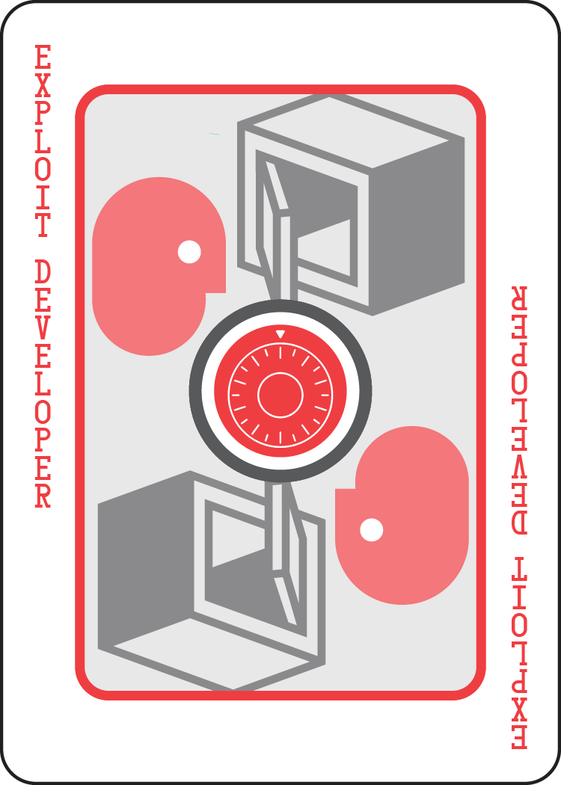
Why to Roll Your Own
Red Team Top Trumps – The Exploit Dev.
Attributes
Specialist
Often focused on a specific architectures
Deeply technical
Creativity – 6/10
Nerd Quotient – 8/10
££££ / 5

Slide 9
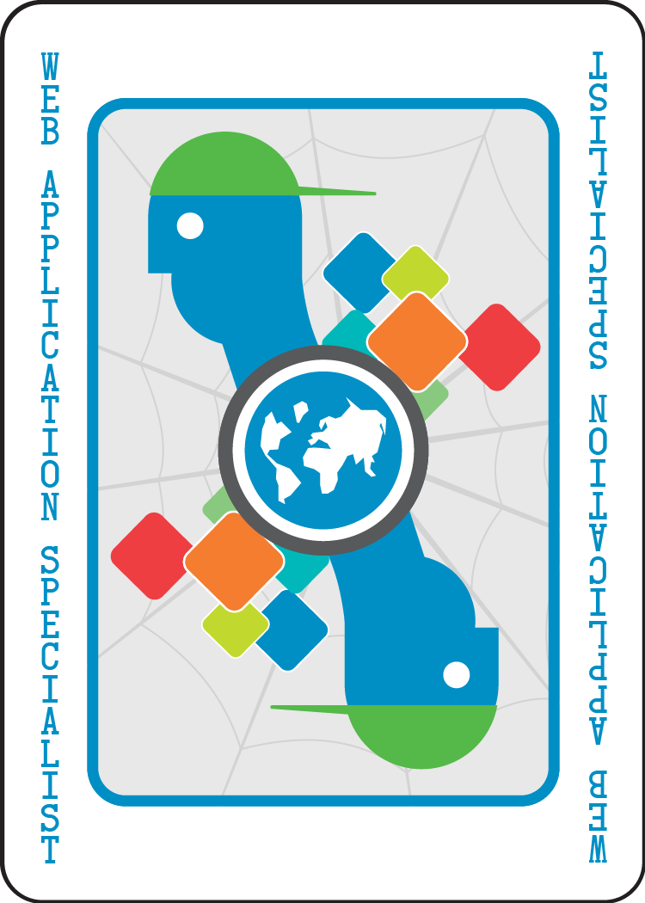
Why to Roll Your Own
Red Team Top Trumps – The App. Specialist
Attributes
Often from a dev. background
Will have some key languages and platform expertise
Often has infrastructure skills too
Creativity – 7/10
Nerd Quotient – 7/10
£££ / 5

Slide 10
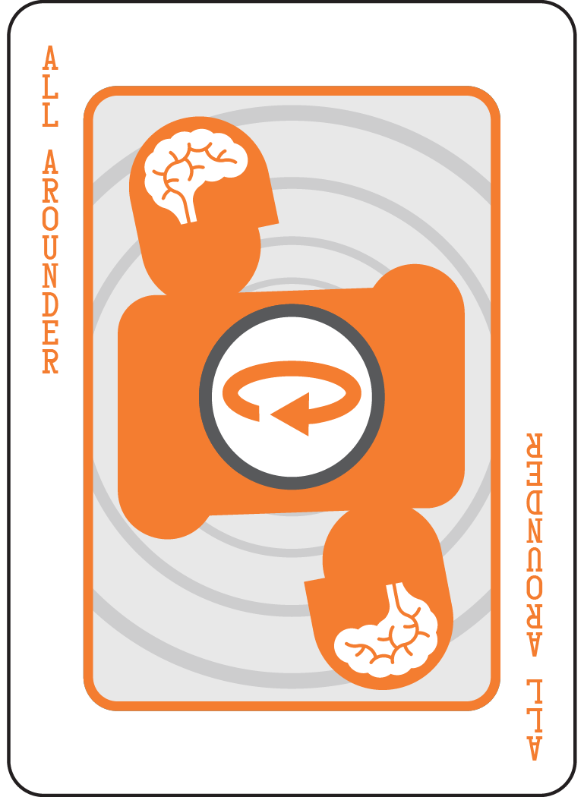
Why to Roll Your Own
Red Team Top Trumps – The All-rounder
Attributes
Long tenure in the industry, seen it all
Often useful for managerial responsibility
Strategist
Probably owns a ham radio
Creativity – 6/10
Nerd Quotient – 7/10
££££ / 5

Slide 11
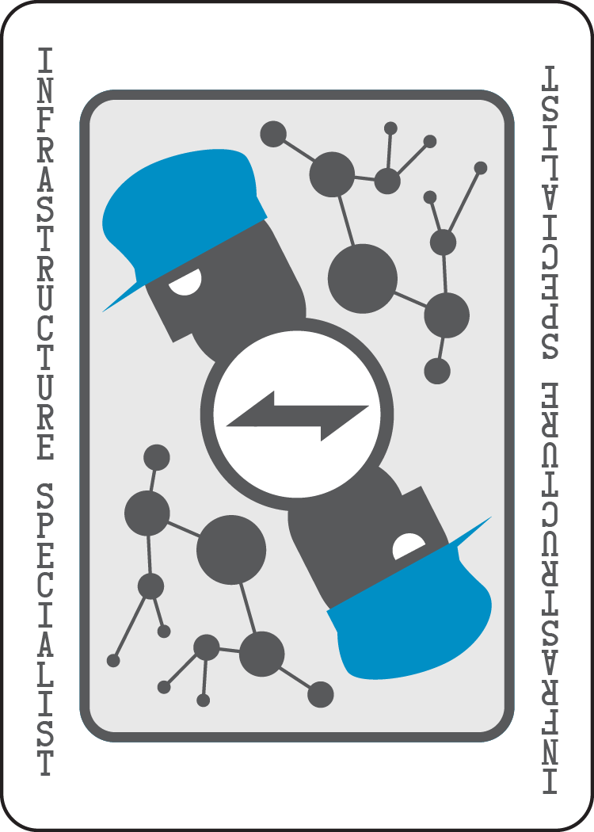
Why to Roll Your Own
Red Team Top Trumps – The Infra. Specialist
Attributes
OS expert
Network expert
Often from architecture or net. background
Often Mac or Linux zealot
Creativity – 7/10
Nerd Quotient – 8/10
£££ / 5

Slide 12
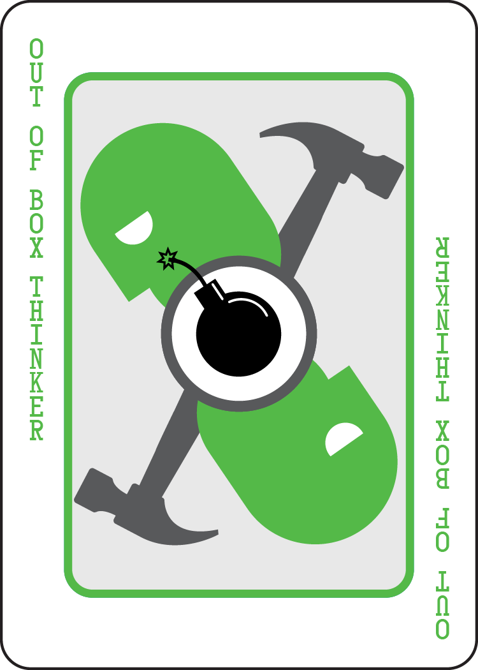
Why to Roll Your Own
Red Team Top Trumps – Out-of-the-box Thinker
Attributes
Could be from anywhere
Often an all-rounder
Often very active in the community
Risky hire (Sometimes)
Creativity – 10/10
Nerd Quotient – 8/10
££££ / 5

Slide 13
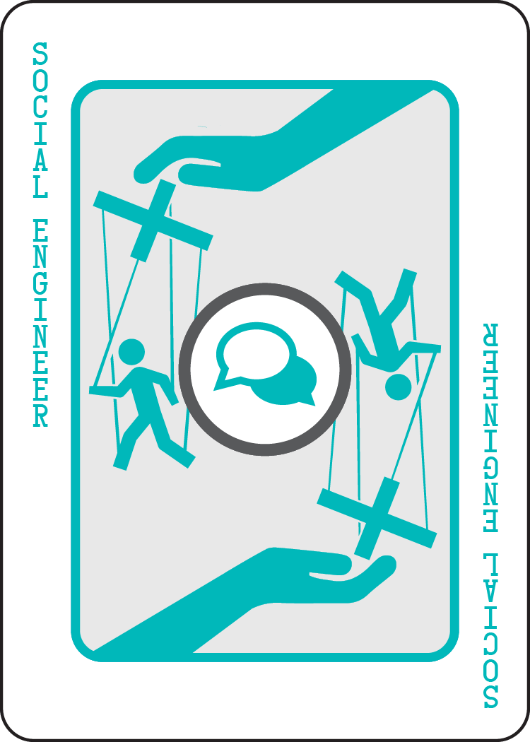
Why to Roll Your Own
Red Team Top Trumps – The Social Engineer
Attributes
Technical background
Often a has another specialism
Knowledge of NLP
Creativity – 9/10
Nerd Quotient – 5/10
££££ / 5

Slide 14
Why Not to Roll Your Own
Budget and Value for Money
Lack of knowledge
Belief that external providers have greater expertise
Don’t see the benefit
Lack of justification to business stakeholders

Slide 15
Legal Issues (In the UK)
I’m not a legal expert
You should speak to a legal expert
Computer Misuse Act (1990)
Section 3a creation of malware
Human Rights Act (1998)
Article 8 – Right to respect for private and family life
Data Protection Act (1998) –
Principle 6 – right to claim compensation
Principle 7 – data should be stored securely, ICO can fine
Principle 8 – data not stored overseas
The Police and Justice Act (2006) –
Section 37 extends section 3a of CMA

Slide 16
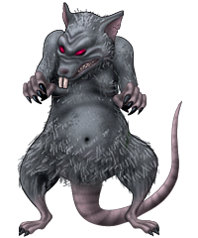
Execution - RATs
What are Implant Frameworks (RATs)
Implant Security Controls
Removal (after time, manual)
Encrypted comms channels
Encrypted local data store
Attribution and identification
Logging
Persistence controls (reboots)
Stealthy, Beacon domains registered
Delivery mechanism control

Slide 17
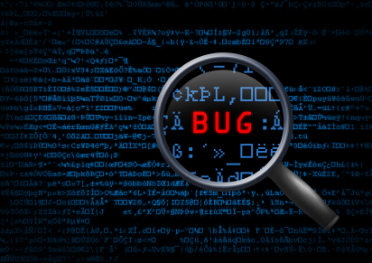
Execution
Attack Vectors
Social engineering
Spearphishing
Physical entry
Phone-based pretexting
Common Vectors
Watering hole attack
Dead drops

Slide 18
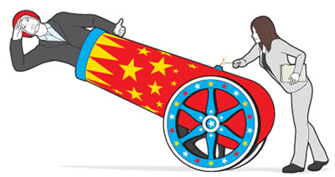
The Importance of Closure
Lessons learned
Report styles
Remediation activity discussions
Expect value from the Red Team
Report reconciliation
Stakeholders
Who should benefit?
Feedback into Threat and Risk models
SOC
SIEM alerts
Patterns
Update IR Playbooks

Slide 19
Questions?

